Slide 1
Physically-Aware Secure Software Execution
Mark Tehranipoor
Chair, ECE Department, Intel Charles E. Young Endowed Chair Professor at University of Florida, Founder, Caspia Technologies

Slide 2
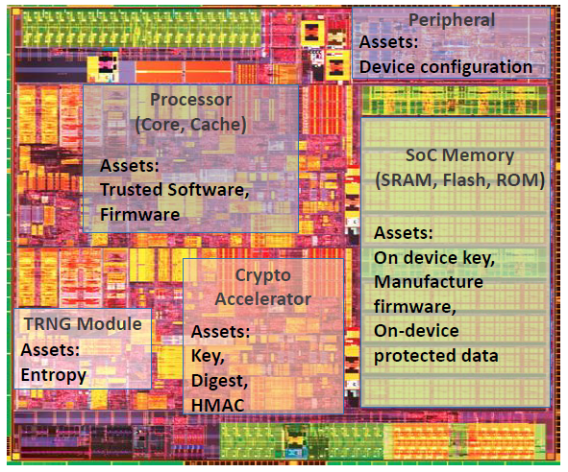
Problem Statement
Problem: Protect assets
On-device keys (crypto/obfuscation)
Manufacturer firmware
Application software
On-device sensitive data, etc.
Software running on vulnerable circuits are not secure
Software executed in SoCs, processors, IoT devices, and smartphones is susceptible to both cyber attacks and hardware attacks
Physical attack targets the implementations, bypassing upper-level protections; it’s a powerful attack type compromising the confidentiality, integrity, and availability of modern chips
Software developers/compilers are not informed of physical attacks (fault injection, side channel, data extraction, etc.)
The only existing physical modeling in compilers is based on unrealistic software-based predictions
Source: Intel

Slide 3
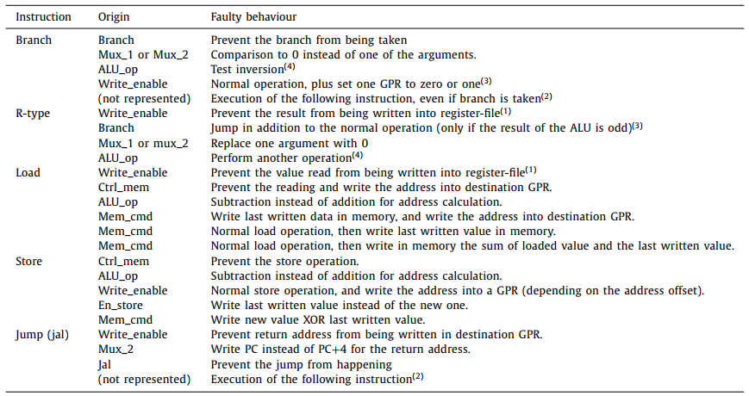
Problem Statement
A Simple Example to Motivate the Work:
The faulty behavior in many different types of RISC-V instruction shows a powerful potential for attackers to manipulate the program execution
Notes:
Faults marked with a number are complex/combined faults, explained in reference paper 5.

Slide 4
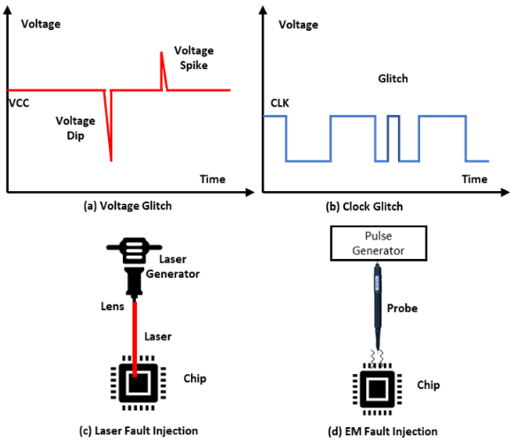
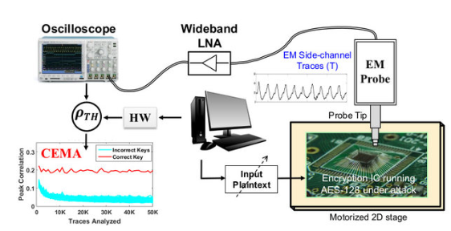
Problem Statement
Physical Attacks
Fault-injection attack (FIA)
Clock/voltage glitching, laser/optical fault-injections, EM fault-injection
Side-channel attack (SCA)
Leakages from power, EM, optical, thermal, acoustic, etc.
Can be monitored and analyzed to leak sensitive info
Side channel attack flow
Illustration of different physical fault injection attacks

Slide 5
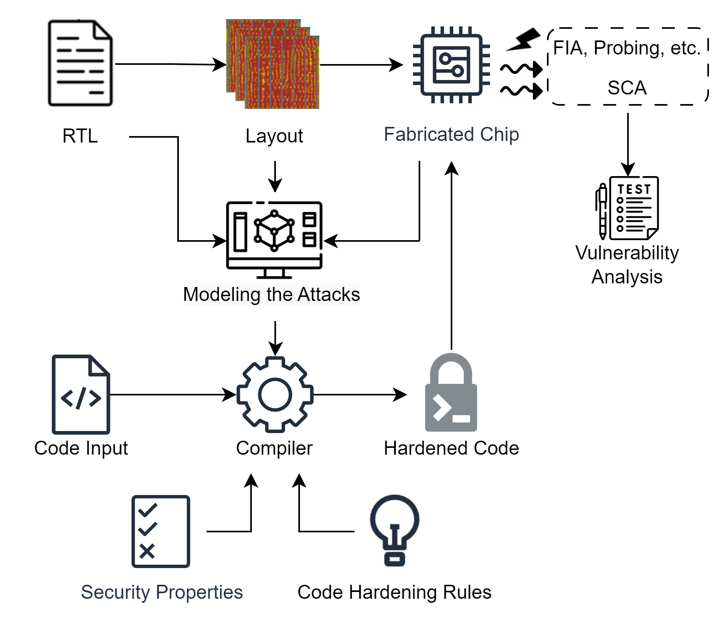
Motivations and Goals
Motivations
Addressing physical threats from code compilation is fast, powerful, scalable, and cost-effective
Existing physical modeling in compilers is on based on software-side predictions
Objectives
The objective is to harden the software code against as many physical vulnerabilities as possible at the compilation stage.
Effective physical modeling to help improve the compilation process
Making code resistant to physical attacks at compilation stage
Software Hardening against Physical Attacks at Compilation

Slide 6
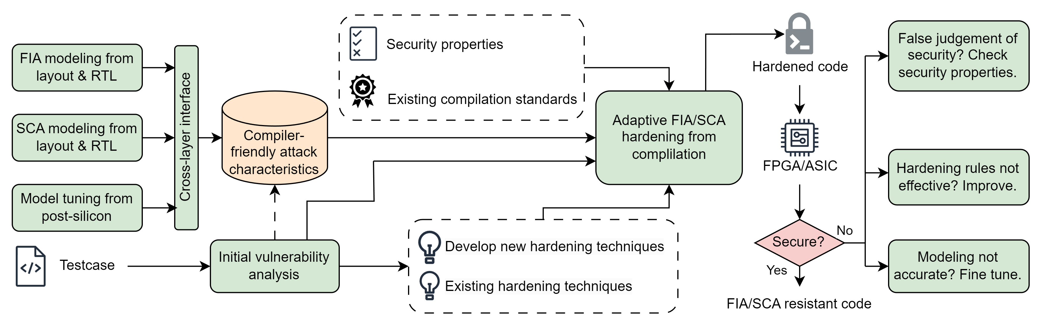
Project Tasks and Timeline
Task 1: Attack Modeling
Task 2: Compiler Development
Task 3: Evaluation
 | Year 1 |  | Year 2
Task 1: Attack Modeling
Task 2: Compiler Development
Task 3: Evaluation

Slide 7
Task 1: FIA/SCA Modeling
Technical Approach
Understand the logical impact of FIA/SCA
Understand the physical behavior of FIA/SCA
Through RTL/layout-level/post-silicon simulations and experiments, model the FIA/SCA effects under given input parameters
For FIA, laser/optical fault-injections, clock/voltage glitching, and EM fault-injections have different mechanisms and modeling approaches
Identify the cross-layer effects: how does the physical fault eventually impact the code execution?
Deliverables
Model equations or look-up tables

Slide 8
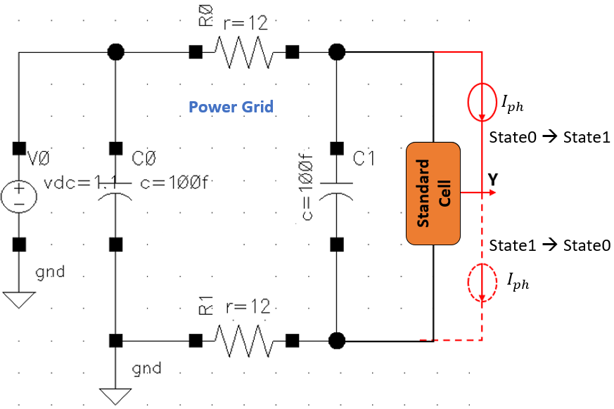

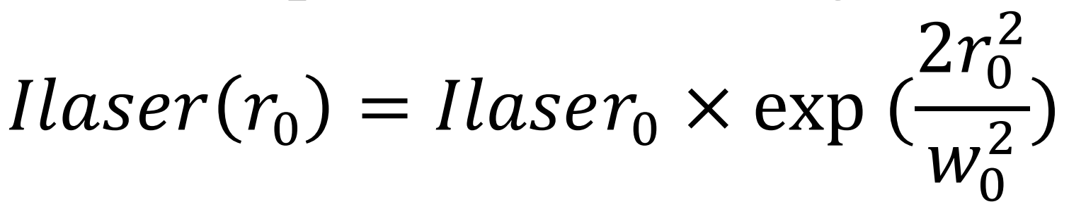
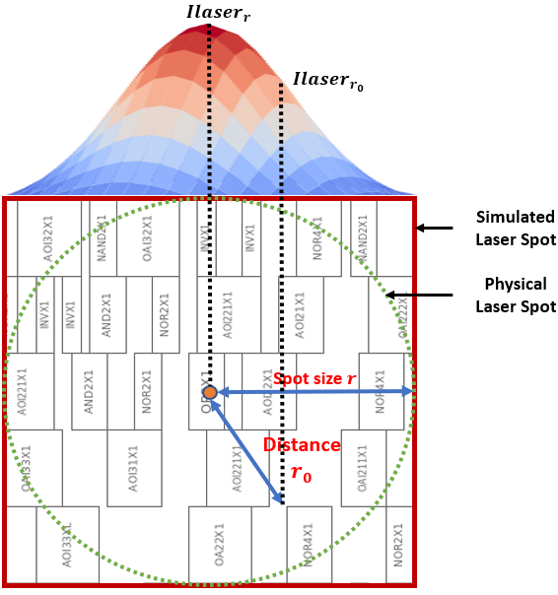
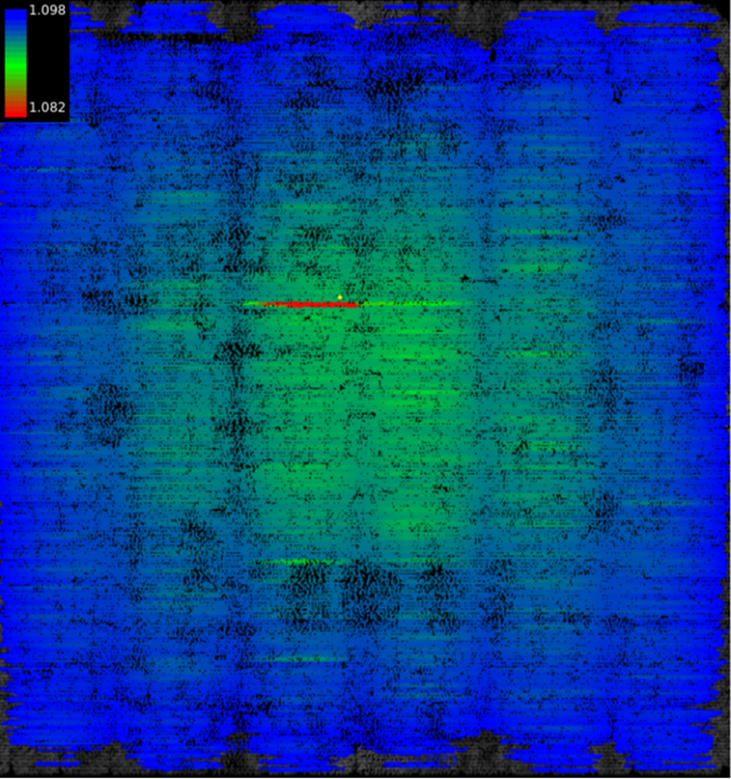
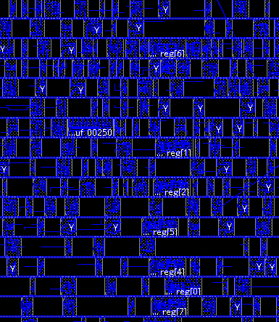
Task 1: FIA/SCA Modeling
Example: laser fault-injection modeling from layout info
Laser effect can be modeled as extra current sources in SPICE simulations, then applied in dynamic IR drop simulations (result: build a connection between laser intensity per cell and cell’s accurate current demand)
Cells’ current demand under laser impact will determine whether the fault can be injected
Example: clock/voltage glitch modeling from layout info
Clock/voltage glitch causes timing violations across the sequential components
Can be modeled as delay changes, i.e., converting fault to time
Repeat for all type of standard cells
Voltage drop simulation on the layout
Substitute impacted cells’ current
response with laser-impacted version

Slide 9
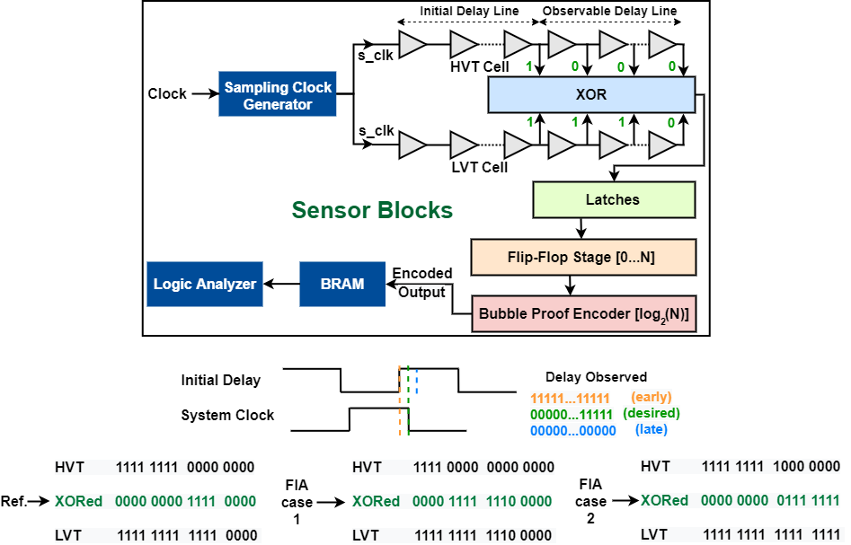
Task 1: FIA/SCA Modeling
Example: laser fault-injection modeling from layout info
Laser effect can be modeled as extra current sources in SPICE simulations, then applied in dynamic IR drop simulations (result: build a connection between laser intensity per cell and cell’s accurate current demand)
Cells’ current demand under laser impact will determine whether the fault can be injected
Example: clock/voltage glitch modeling from layout info
Clock/voltage glitch causes timing violations across the sequential components
Can be modeled as delay changes, i.e., converting fault to time

Slide 10
Task 2: Compiler Development
Test case and security properties
Aims for C/C++ -> Assembly code compilation and hardening
Plan to start with firmware, AES software, password checking, etc.
Corresponding security properties acquired from existing standards and powerful attack scenarios
Modeling-compiler interface
Modeling considers logical & physical info, thus, the outcome needs translation to be compiler-friendly
Compiler must provide:
A configurable “hardening level” input to determine the input (e.g., laser intensities) for FIA models
A simple mechanism to determine target instructions (e.g., directly extract sensitive instructions from security properties; or through static code analysis.)
Translation from target instructions to actual instances/area, which serves as final input for models
Compiler must receive:
Feedback from modeling in a compatible form of either 1) a threat level / a vulnerability ranking of inputted sensitive instances, or 2) a simple secure-or-not judgements from modeling under certain parameter inputs

Slide 11
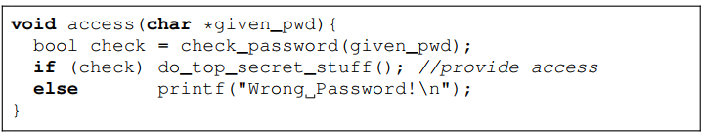
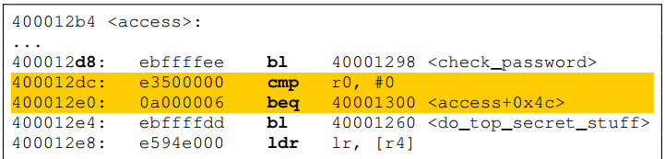
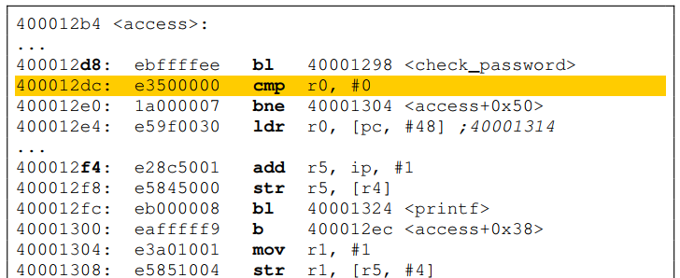
Task 2: Compiler Development
Hardening rules database
Goal: address the physical faults during the compilation process
Review existing hardening approaches
Utilize or imitate existing solutions in RISC-V GNU compiler
Develop adaptive approach to apply countermeasures using the info (e.g., vulnerability ranking) given by modeling output
Deliverables
Encapsulated implementation of hardening compiler
Proper documentations
Compile
Harden
What happened?
Faults modifying/bypassing the conditional jump will now directly lead to a password-checking failure

Slide 12
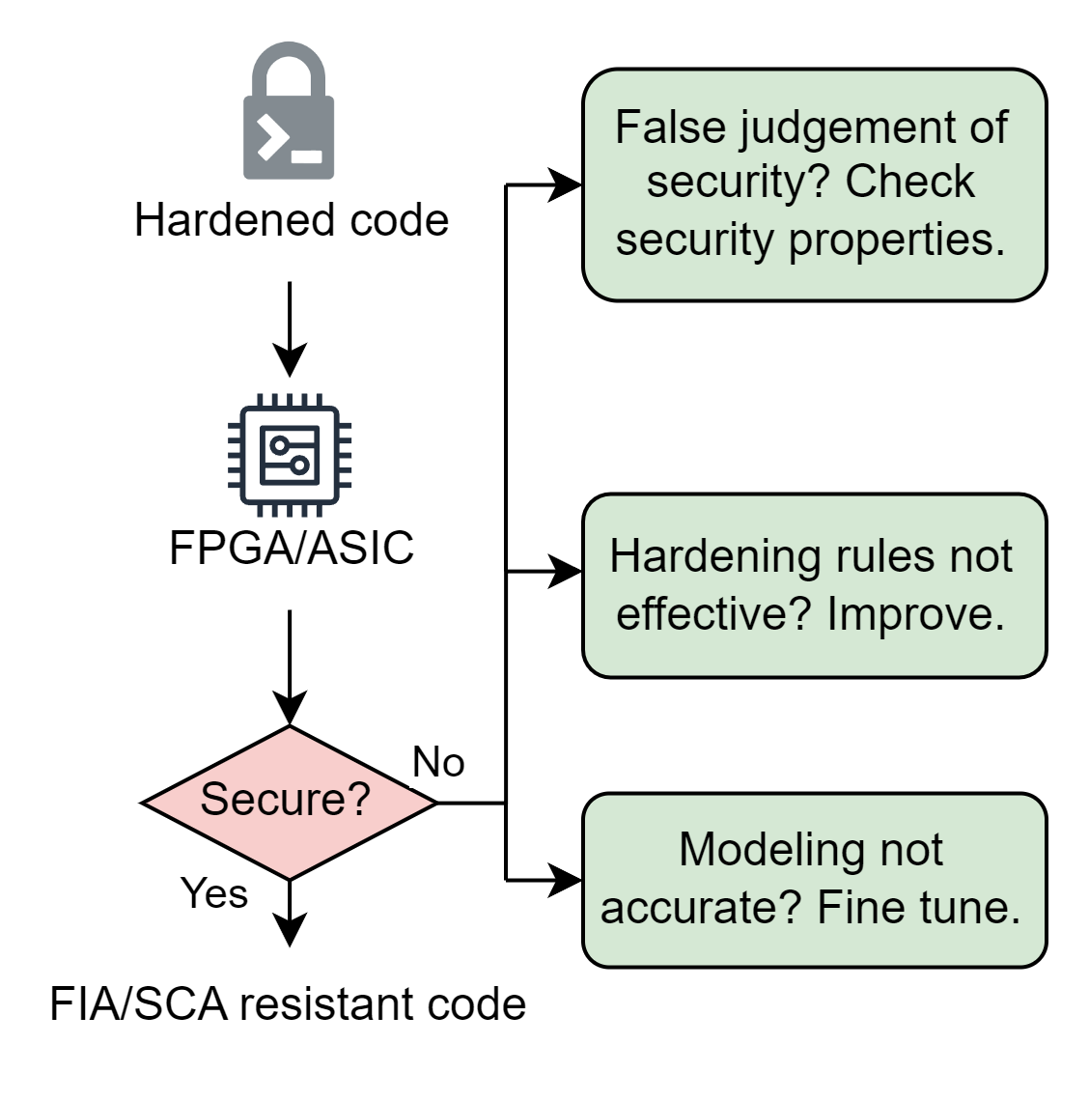
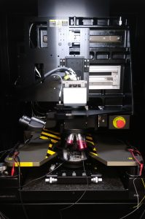
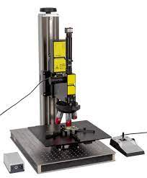
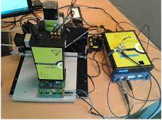
Task 3: Evaluation
Technical Approach
Execute hardened codes on FPGA/ASIC
Perform FIA/SCA vulnerability analysis
Evaluate the hardened code’s resistance, root-cause any issues, automate and improve the compilation flow
Deliverables
FIA/SCA resistant code proven from physical modeling-assisted compilation
FICS lab houses state-of-the-art instruments and capabilities to perform cutting-edge research from device-to-system assurance, security, and integrity analysis.

